Slide 1
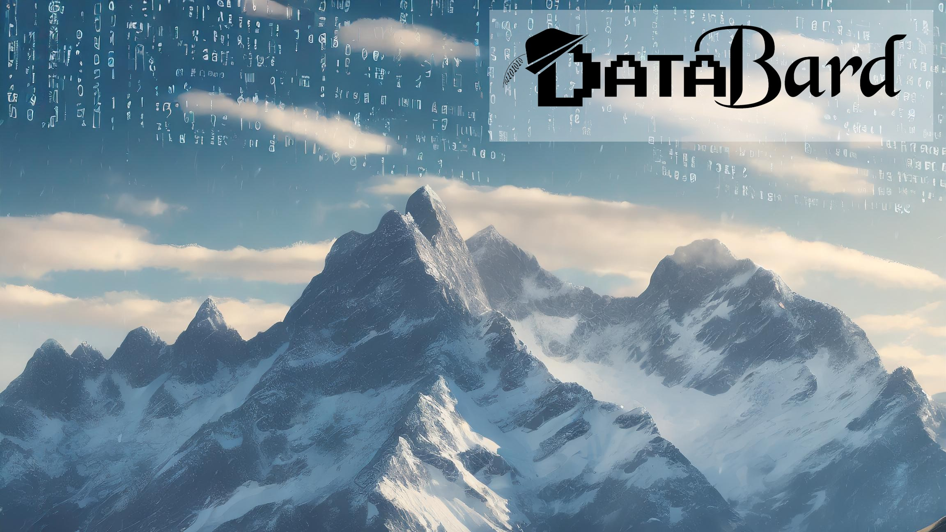

Date: 2025/07/17, Cloud Data Driven Presented by Jared Kuehn
Intro to PySpark in
Microsoft fabric

Slide 2




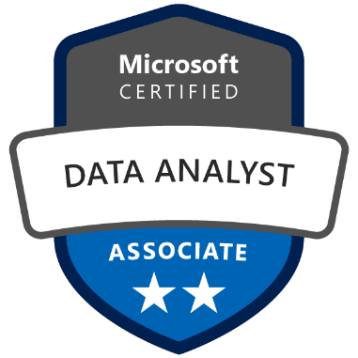




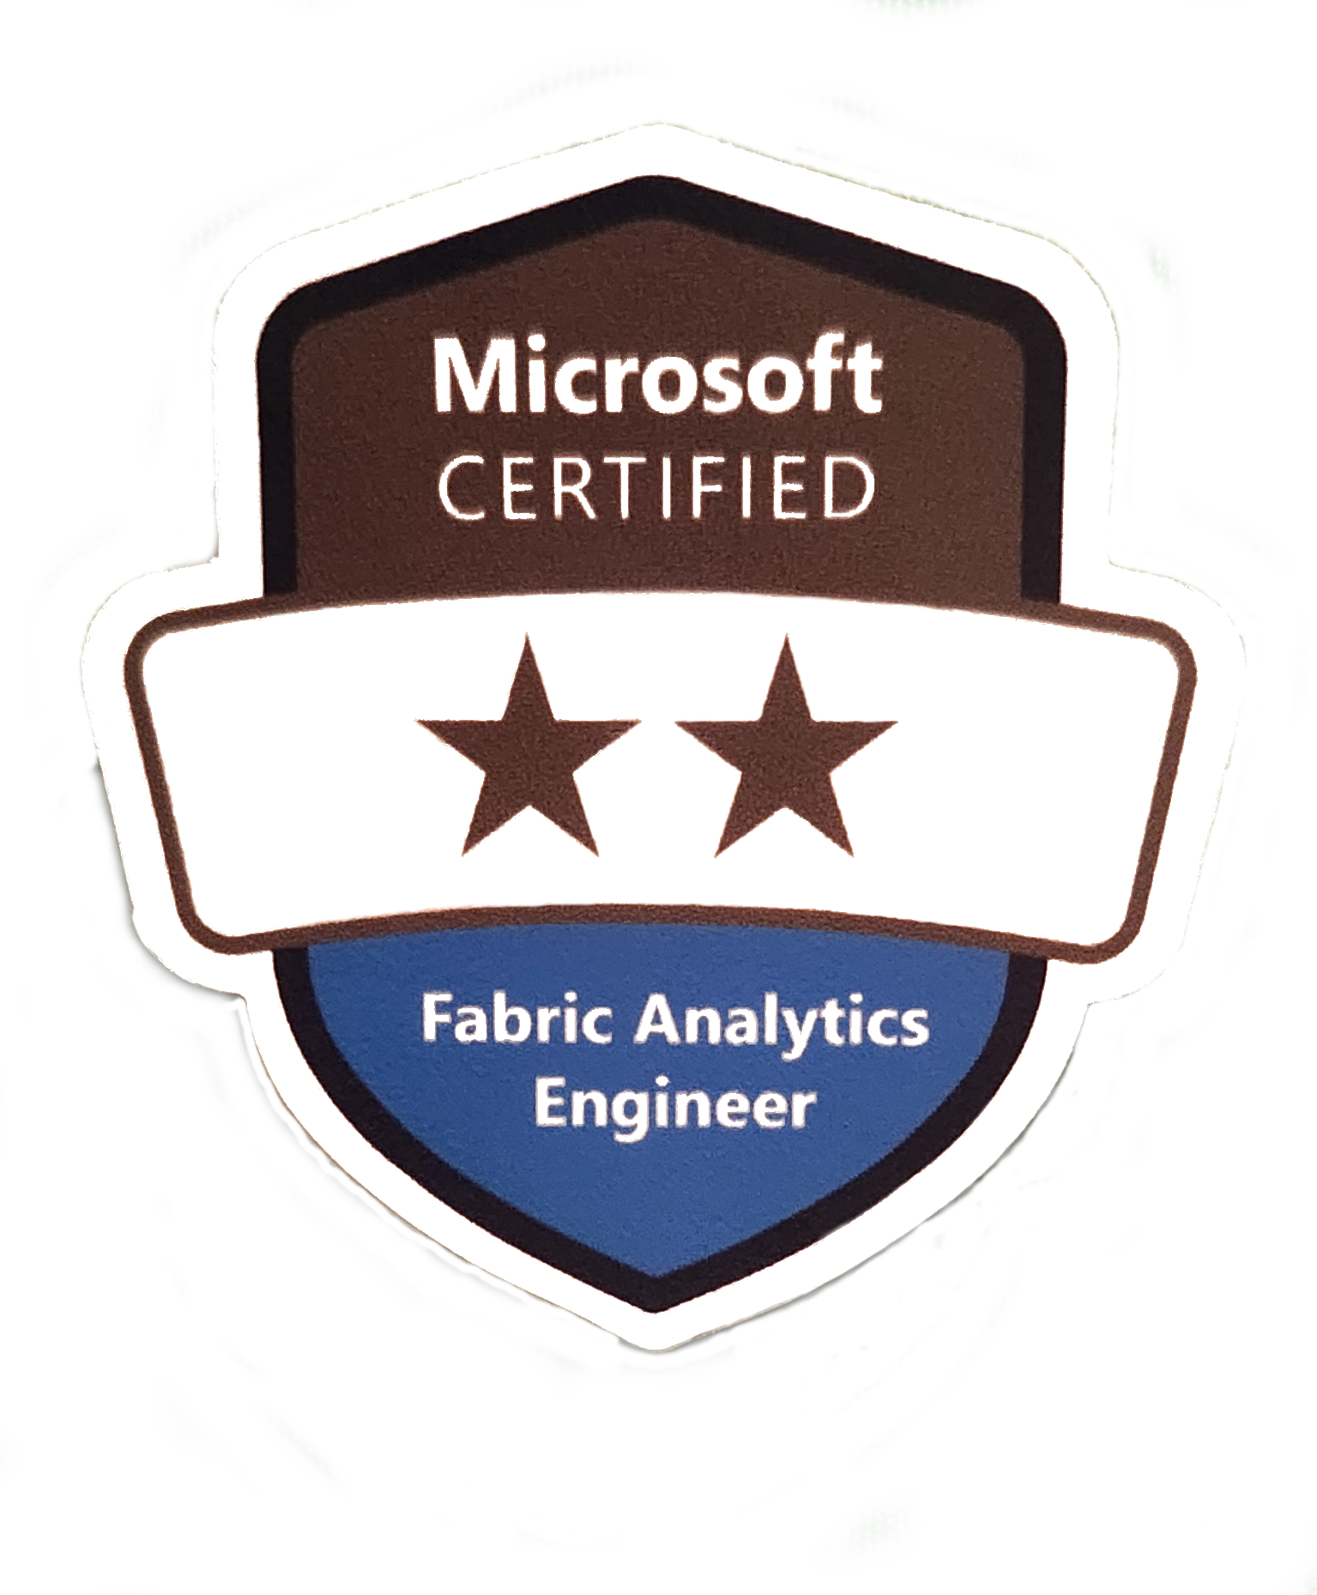
About Me: Jared Kuehn
I am Data Guy
Sr. Data Engineer
10+ years of Data Industry stuff
Non-cloud Certs: MCSE, PSM 1
I am Storyteller
Weird Al is my hero
Played Ophelia in Hamlet
Hat Collector
Notes:
This Bullet Point Slide includes either a lighter mountain range image in the background or a solid color fill. It should be used to summarize the main points that will be discussed in the presentation.

Slide 3

Today's Performance
Python/Spark Fundamentals
Fabric-specific PySpark stuff
Follow-up Resources
Q&A
Notes:
In this presentation, we will cover the following acts: Understanding Data, Theatrical Representation of Statistics, Engaging the Audience, and Closing Act: The Future of Data in Theater.

Slide 4
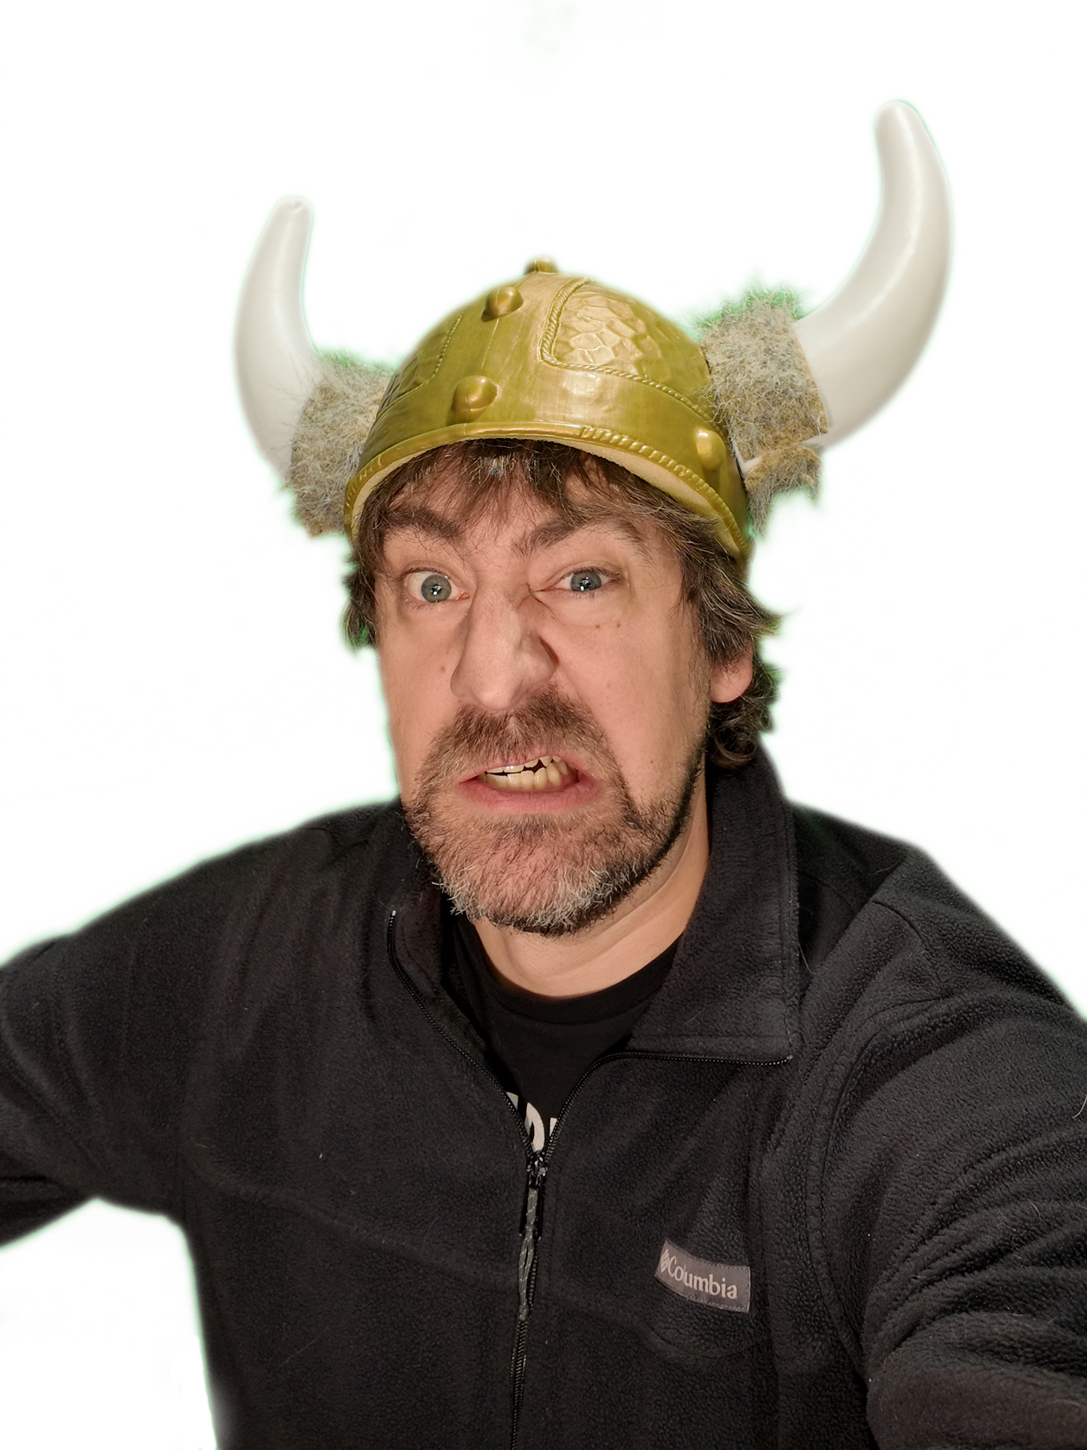
Why PySpark?
Python
3rd Gen Programming Lang
Community Support
Libraries Galore!
Cons
Smaller datasets
Single-node computing
Global Interpreter Lock
PySpark
Python API for Apache Spark
Apache Spark
Distributed Compute clusters
Resilient Distributed Datasets
Big datasets
Libraries specific to big data
Sven the Skeptic
Notes:
In this slide, we will dive into a visual representation of a key data point related to audience engagement in theater performances.

Slide 5
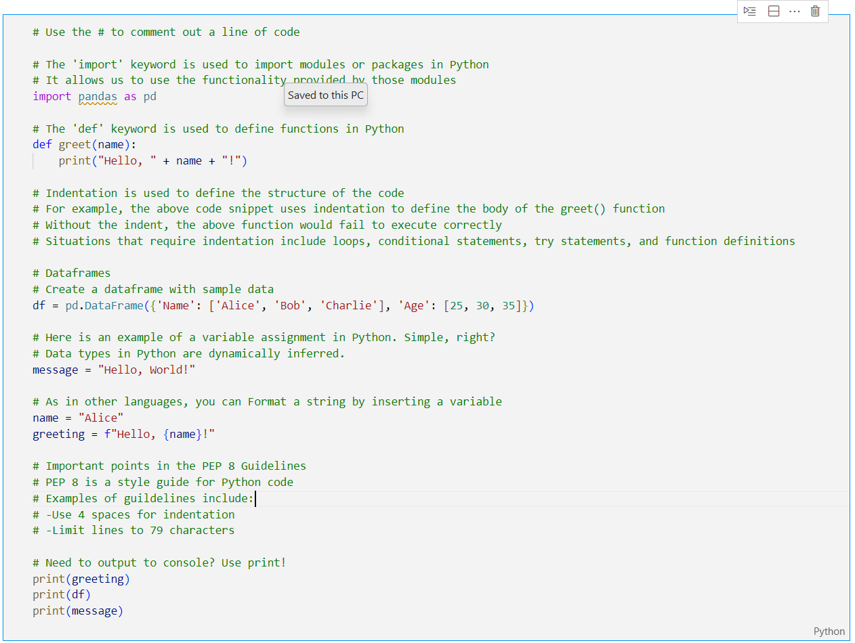
Python Cheat Sheet
Hit the # to comment
Imports = libraries
Def = function
Indents are necessary
Praise be the DataFrame
Variable = anything
Format string
PEP 8 Guidelines
Notes:
In this presentation, we will cover the following acts: Understanding Data, Theatrical Representation of Statistics, Engaging the Audience, and Closing Act: The Future of Data in Theater.

Slide 6
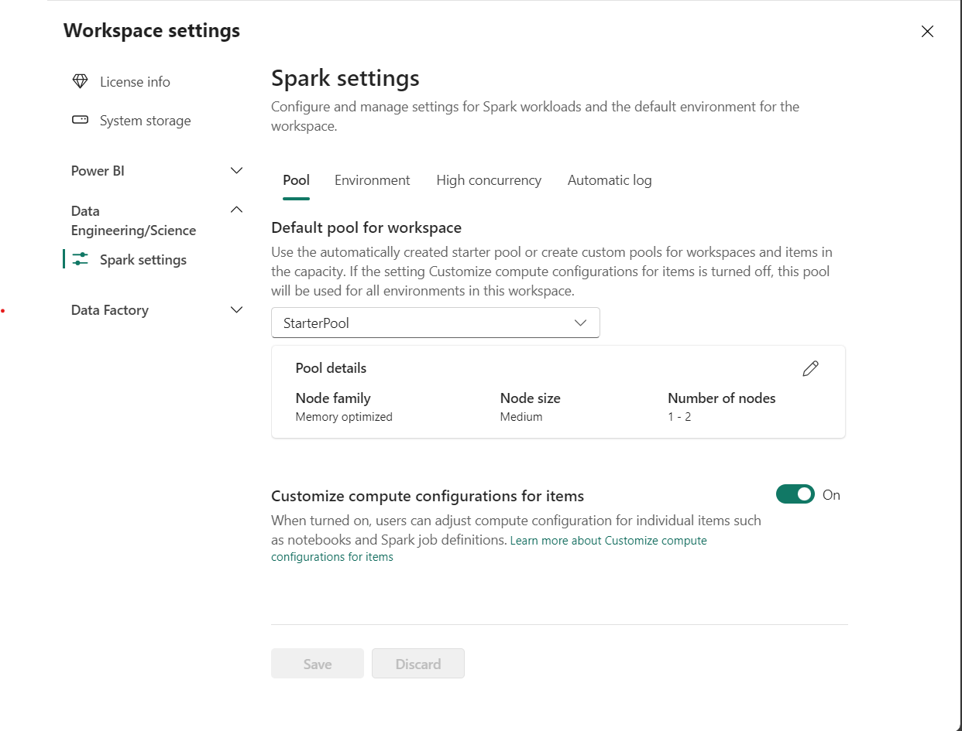
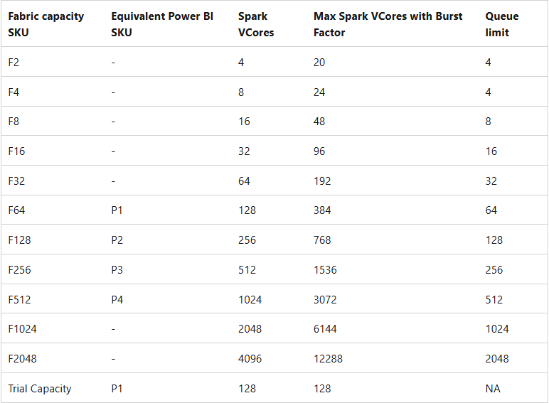

Fabric Admin Topics
Spark Pools = Hardware
Check your capacity!
2 Spark Vcores per CU
Environment = Config
Selected Spark Pool
Runtime
Libraries
Notes:
In this presentation, we will cover the following acts: Understanding Data, Theatrical Representation of Statistics, Engaging the Audience, and Closing Act: The Future of Data in Theater.

Slide 7

Things to cover
UI features bar
Markdown cells
Lakehouse/Warehouse connection
Read/Write
Data Wrangler
Parameter cell
Libraries
Demo!!!!!
Notes:
In this presentation, we will cover the following acts: Understanding Data, Theatrical Representation of Statistics, Engaging the Audience, and Closing Act: The Future of Data in Theater.

Slide 8
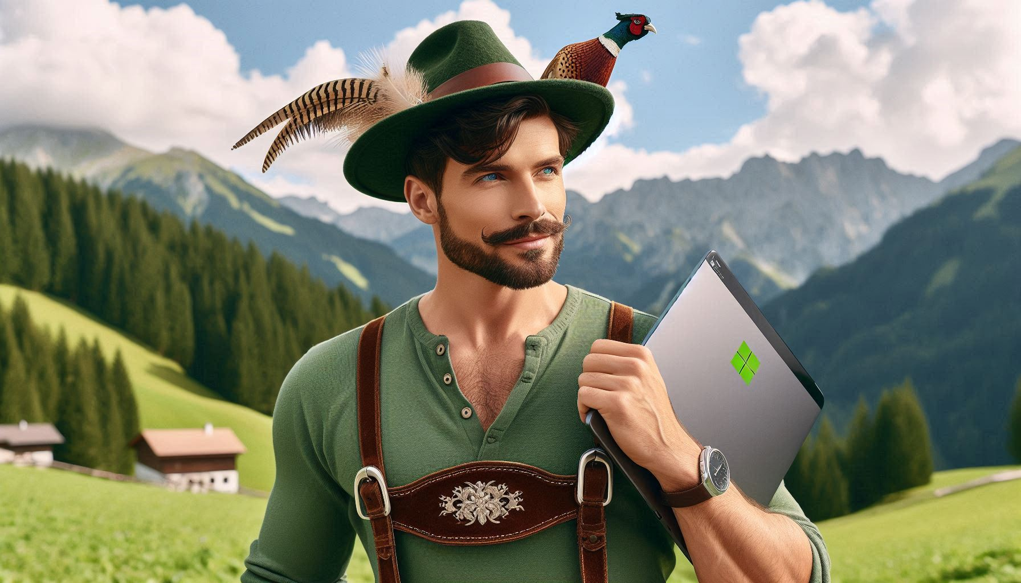
Continue your Journey
Data Wrangler
Copilot
YouTube
Tales From the Field (YouTube)
Programming with Mosh (YouTube)
“Python for Beginners – Learn Python in 1 Hour”
DataBard
Fabric Community (Website and LinkedIn)
Microsoft Fabric Learning
Microsoft Fabric Community
Microsoft Learn and Blogs
Using FabricRestClient To Make Fabric REST API Calls (SemPy)
NotebookUtils (former MSSparkUtils) for Fabric - Microsoft Fabric | Microsoft Learn
Notes:
In this presentation, we will cover the following acts: Understanding Data, Theatrical Representation of Statistics, Engaging the Audience, and Closing Act: The Future of Data in Theater.

Slide 9
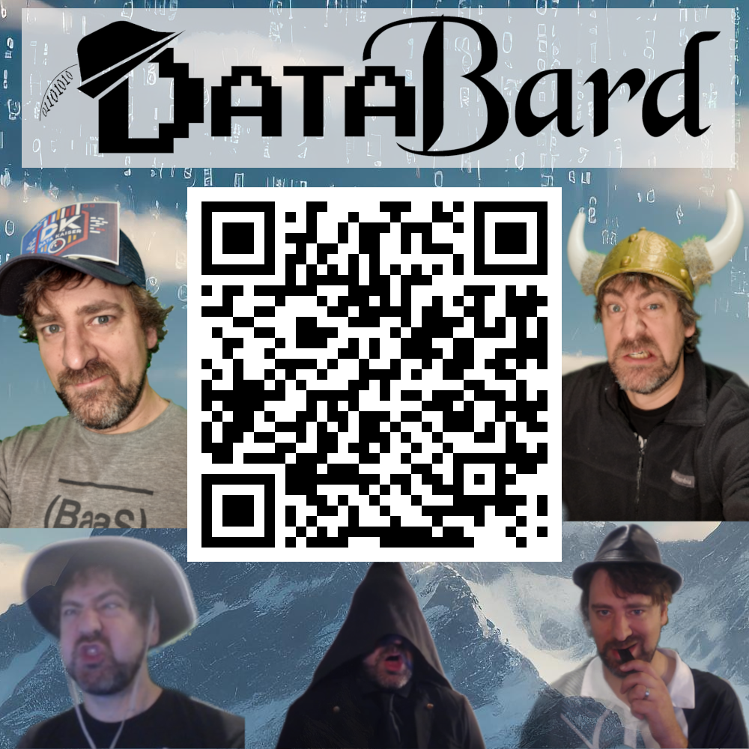
Let’s connect
Check me out on YouTube!
Search ‘Report As A Service’
Jared Kuehn
Architect - Digital Solutions BAKER TILLY
jared.kuehn@bakertilly.com
LinkedIn: /in/databard-jared-kuehn/
BlueSky - @DataBard
GitHub Repo for today’s Demo: https://github.com/databardus/PySparkFabric_Intro

